Slide 1
Take-out system presentation
Kangwen Zhou(001399058)
Yiying Hu(001053766)
Yunwen Sun(001302177)

Slide 2
Problem
Want to Eat out?
Distance
Bad Weather
Illness

Slide 3
solution
Take-out system
Restaurant —Platform—Delivery Company
Order meals online
Have food delivered

Slide 4
Approach
Customer:
Select restaurant and order/update/cancel meals
Platform:
Finance Management
Restaurant:
Finance & Employee Management
Receive/update/cancel orders and prepare meals
Add/update menus
Delivery:
Employee Management
Receive/update/cancel orders and deliver meald

Slide 5
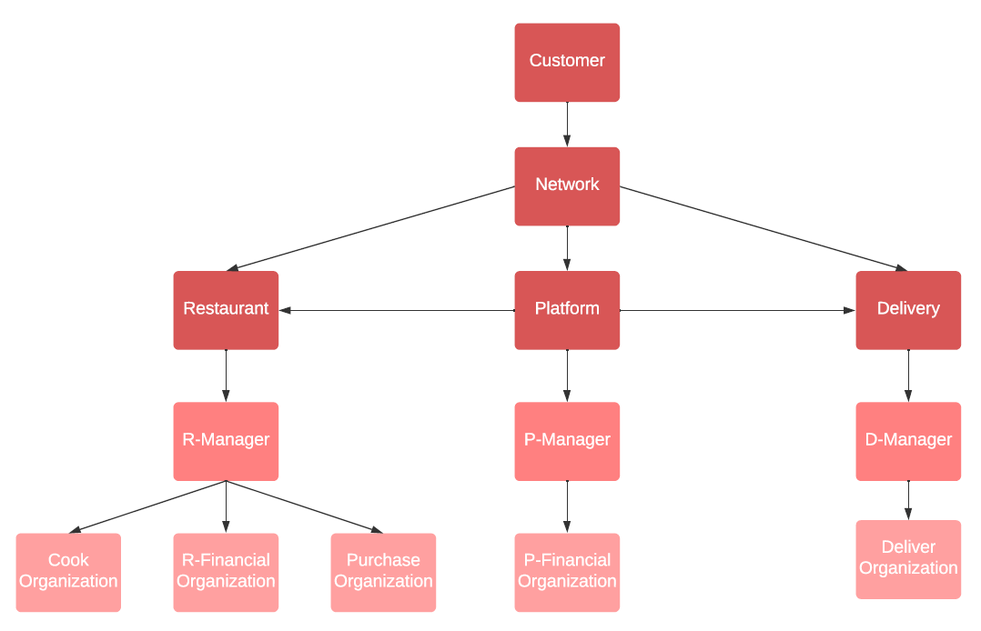
Design

Slide 6
usecase
Networks and Enterprises:
BOS
Restaurant: Popeyes + KFC
Platform：MeiTuan
Delivery: UberEat
LAX
Restaurant: ShakeShack + Uburger
Delivery: HungryPanda

Slide 7
USECASE
All the username is the same as password
Restaurant Employee:
(BOS)Popeyes: PopeyesP + PopeyesF + PopeysC
(BOS)KFC: KFC+KFCF+KFCC
(LAX)ShakeShack: ShakeShackP + ShakeShackF + ShakeShackC
(LAX)UBurger: UBurgerP + UBurgerF + UBurgerC
Platform Employee :
Meituan: MeituanF
Delivery Company Employee :
(BOS)UberEat: UberEatD1 + UberEatD2
(LAX)HungryPanda: HungryPandaD1+ HungryPandaD2

Slide 8
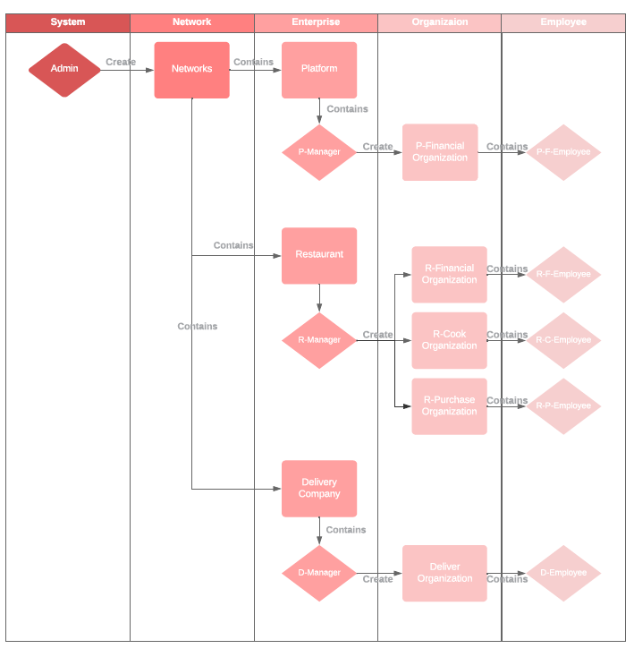
Work flow
1.Manage Employee

Slide 9
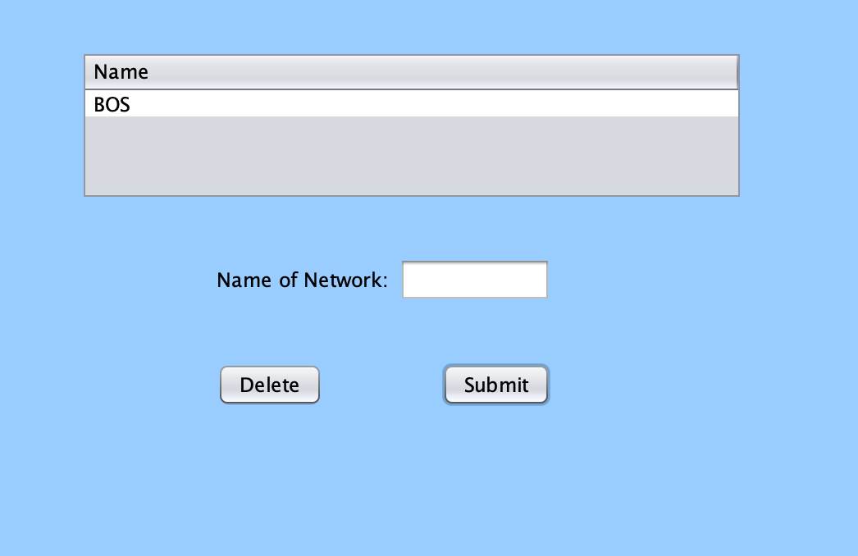
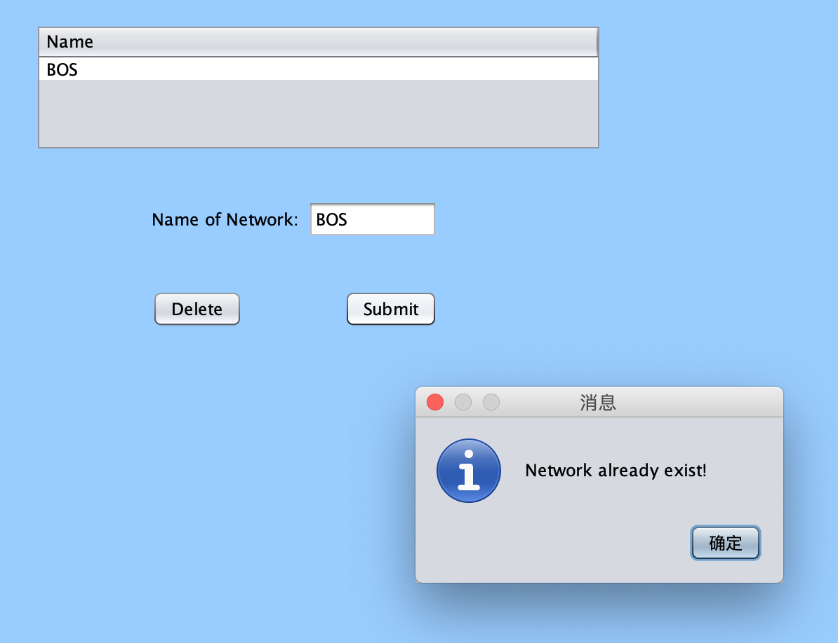
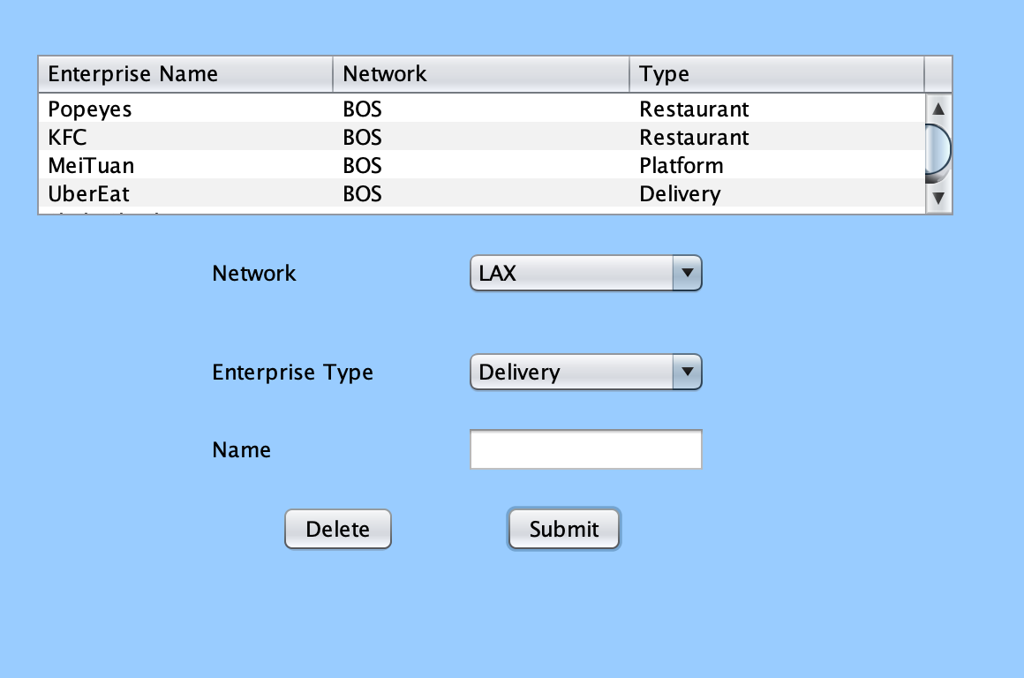
Create Network & Organization

Slide 10
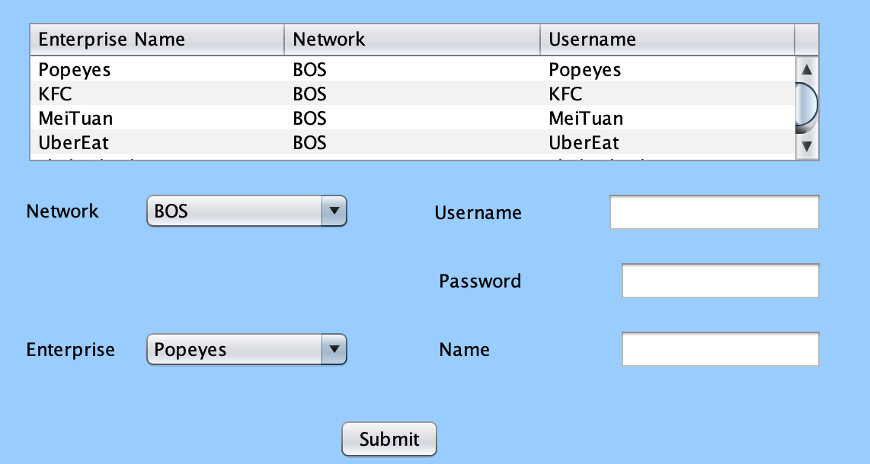
Create Enterprise Manager

Slide 11
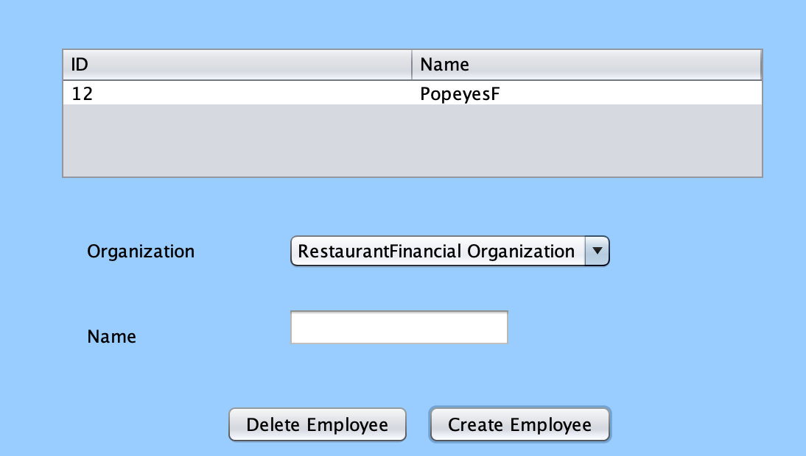
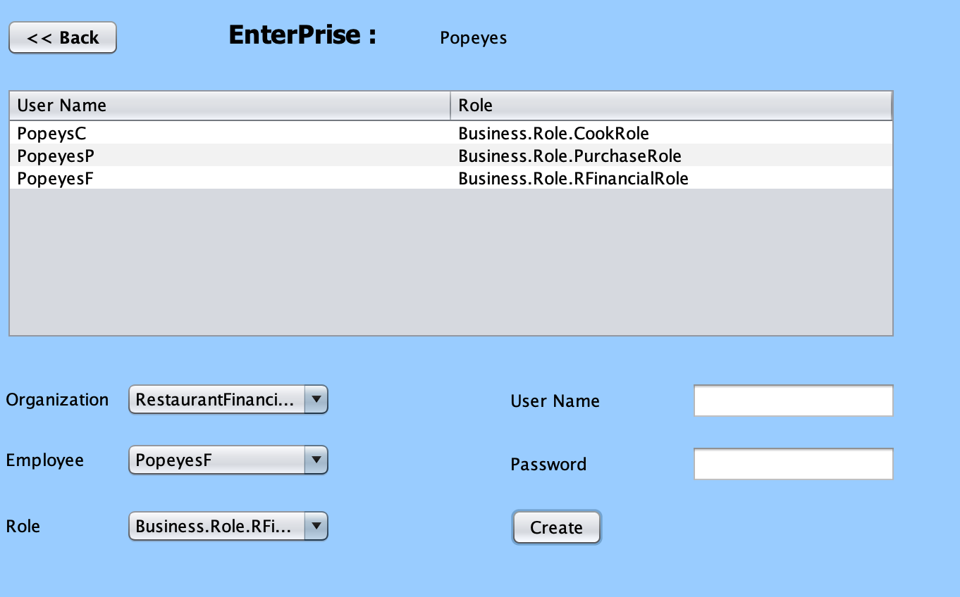
Create Employee & UserAccount

Slide 12
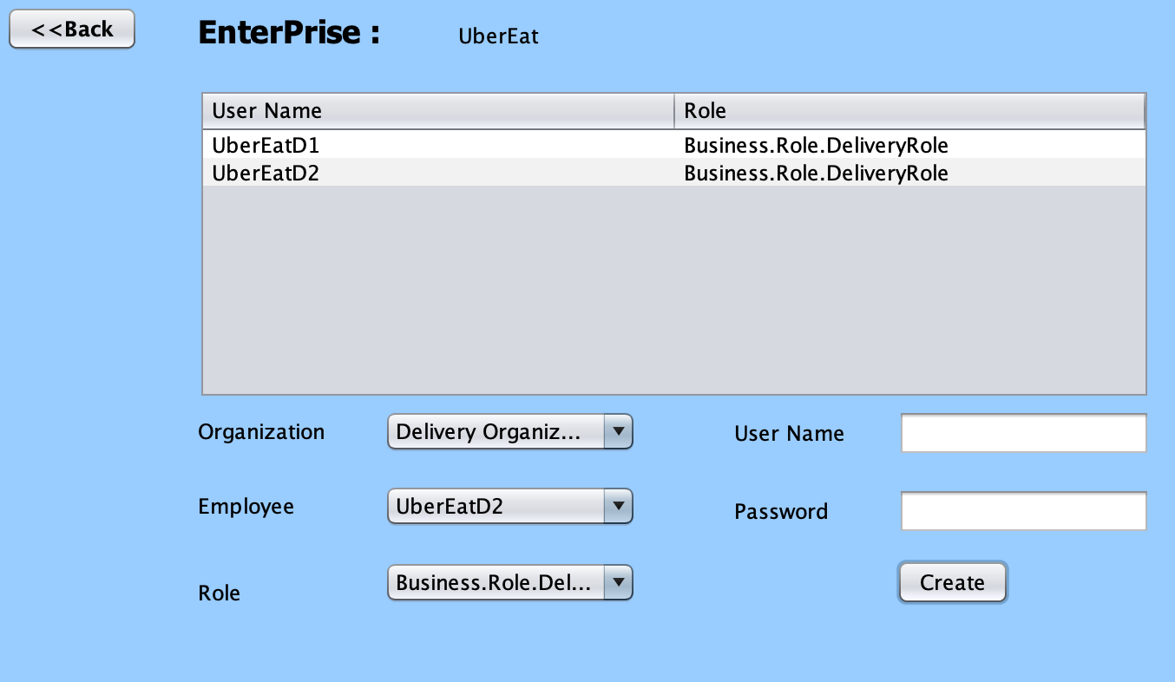
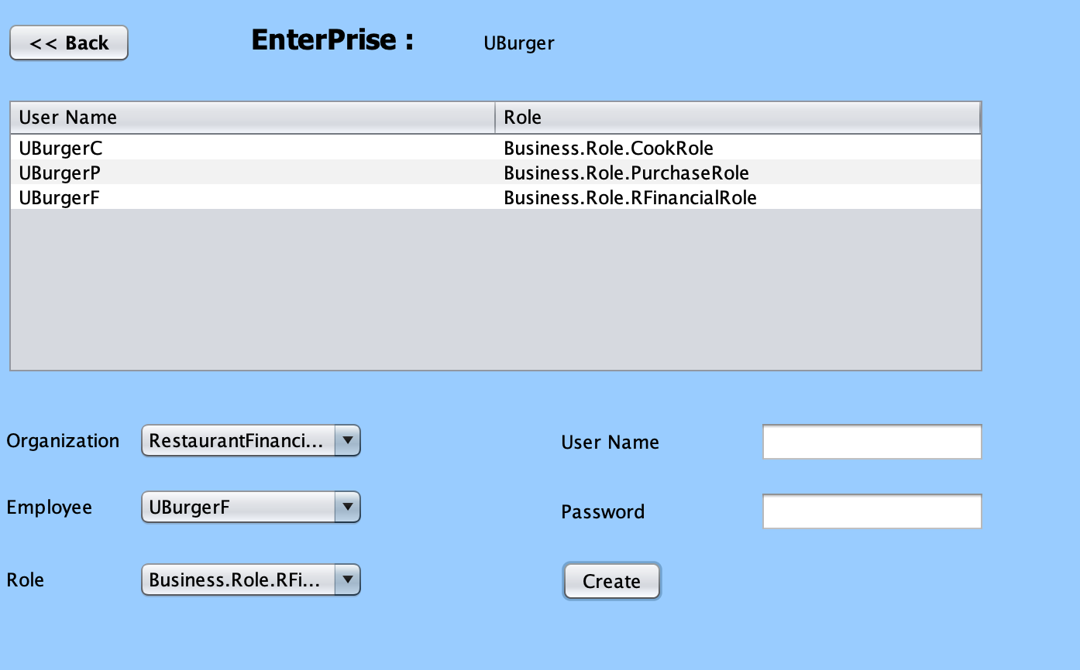
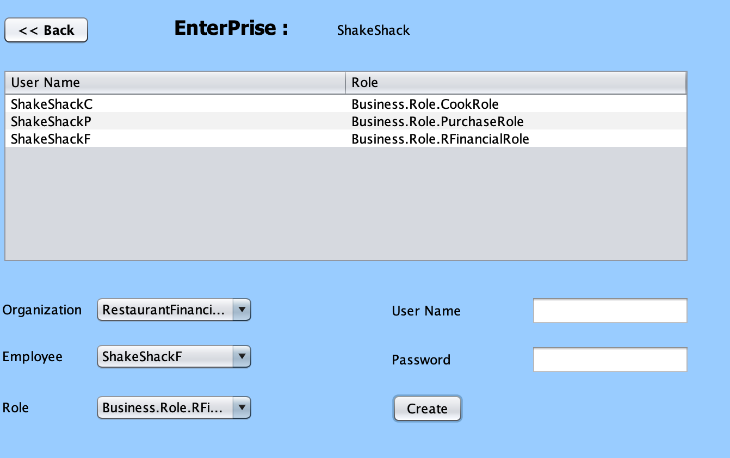
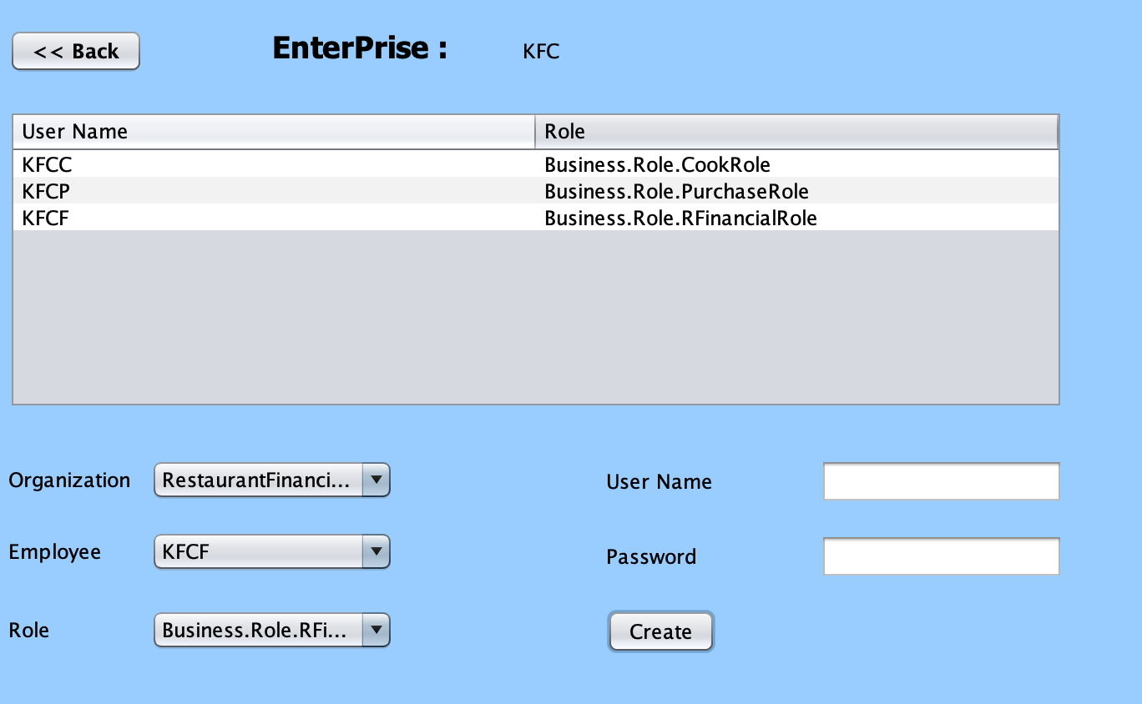
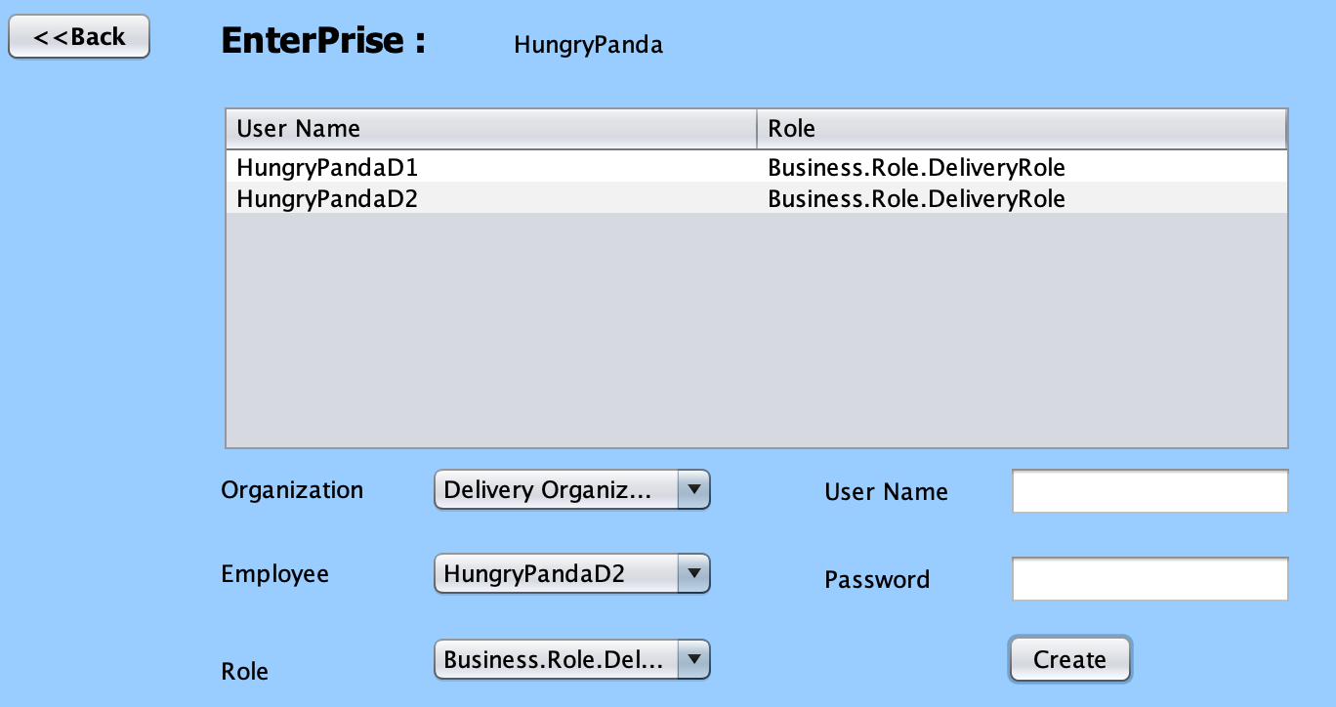
Result

Slide 13
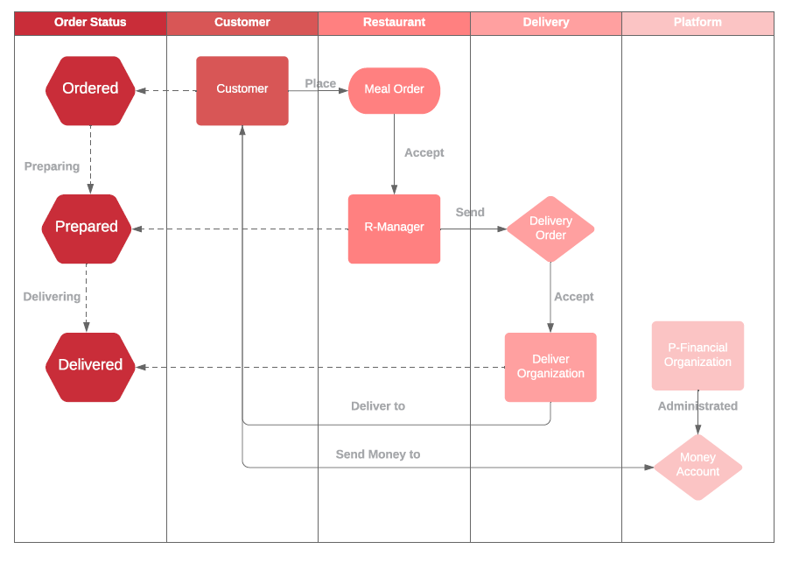
Work flow
2.Order Meals

Slide 14
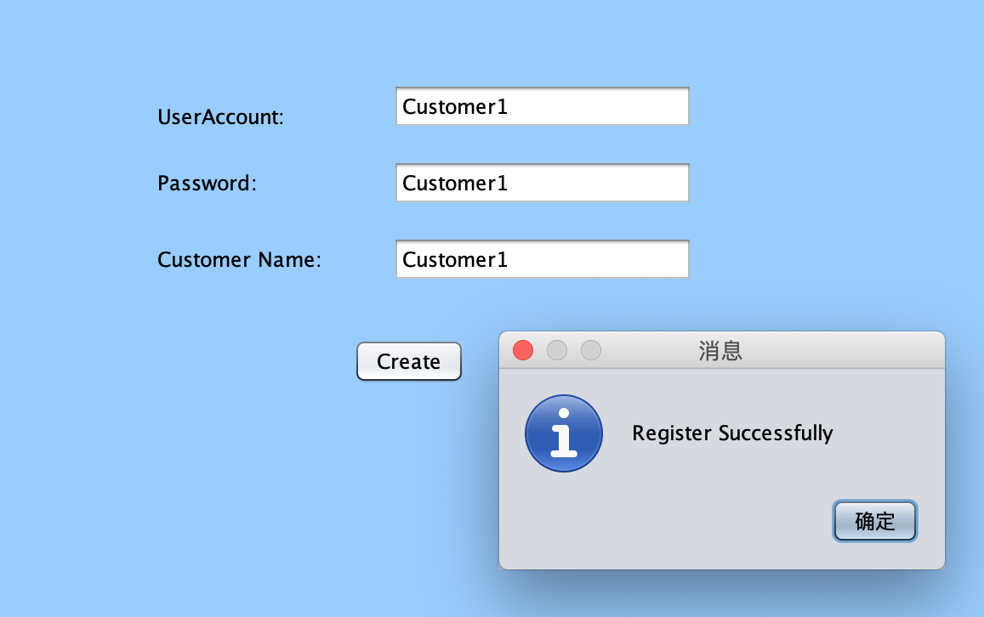
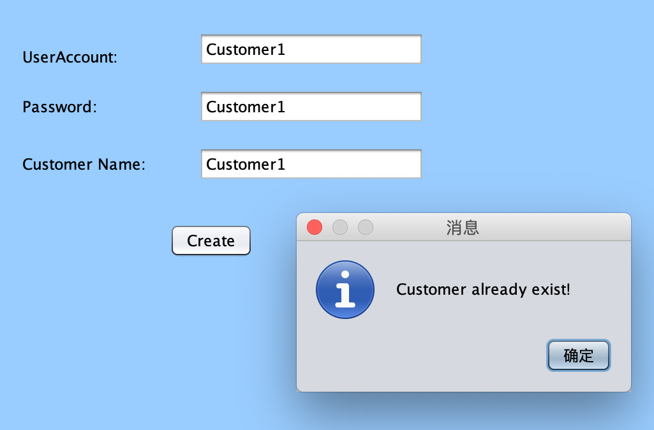
Customer Register

Slide 15
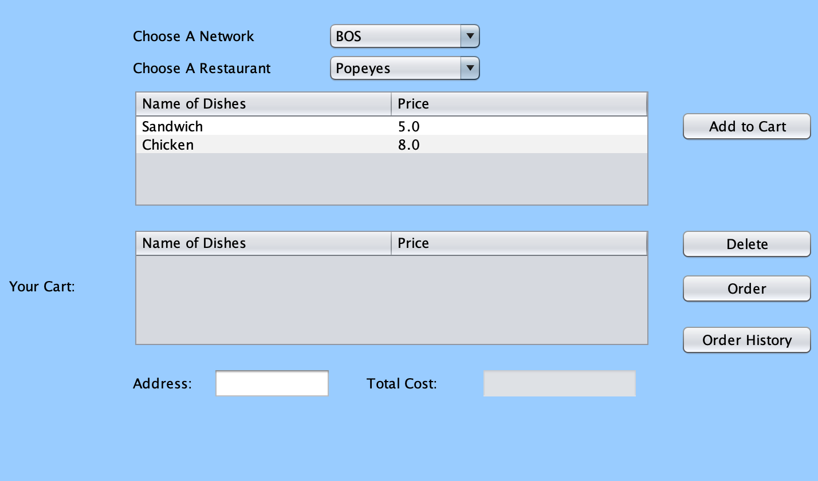
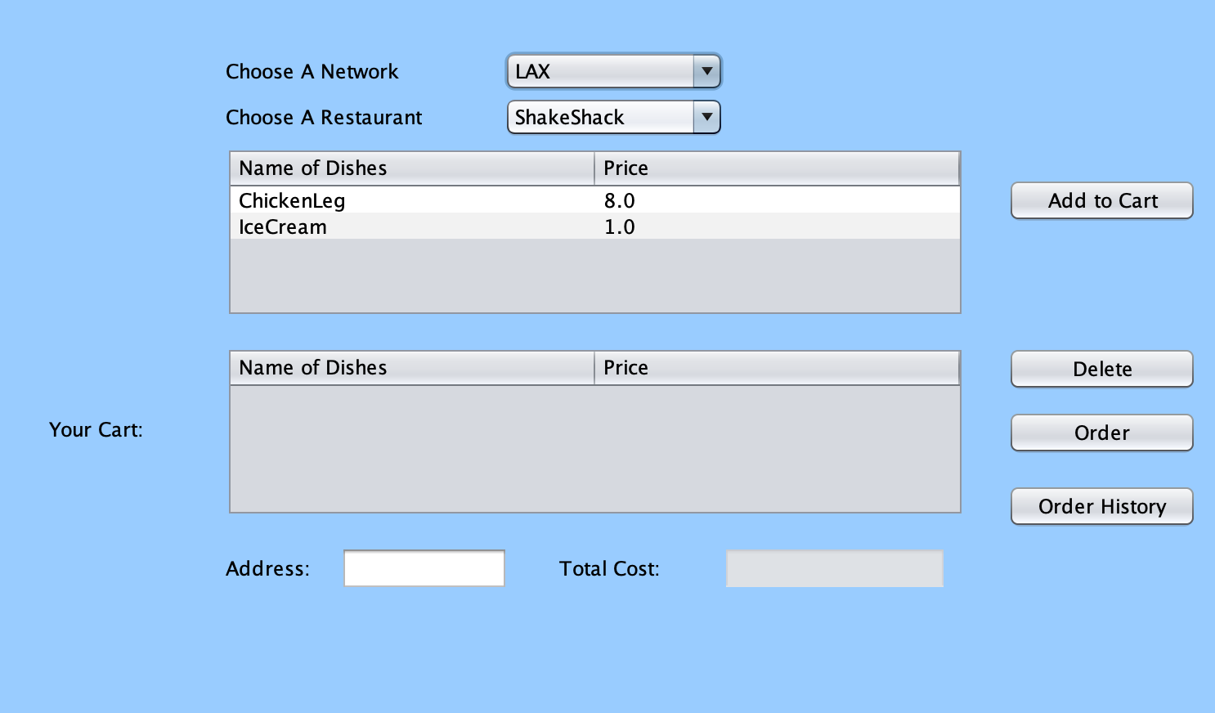
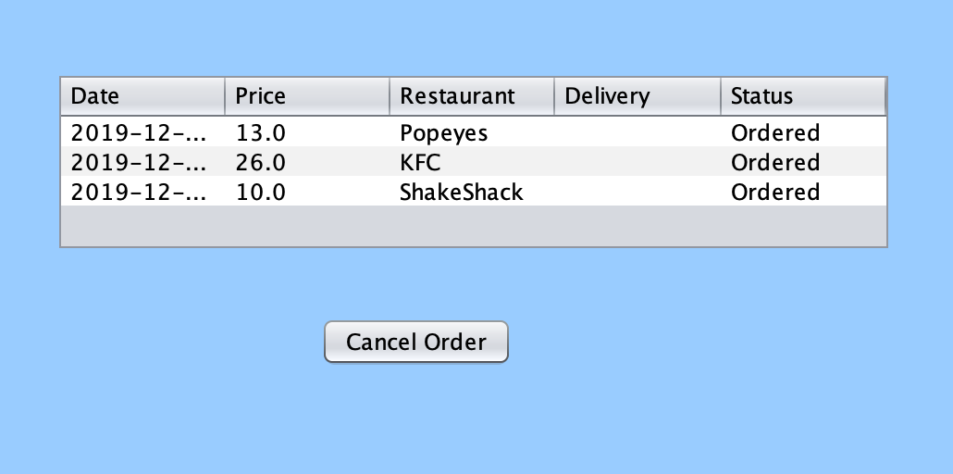
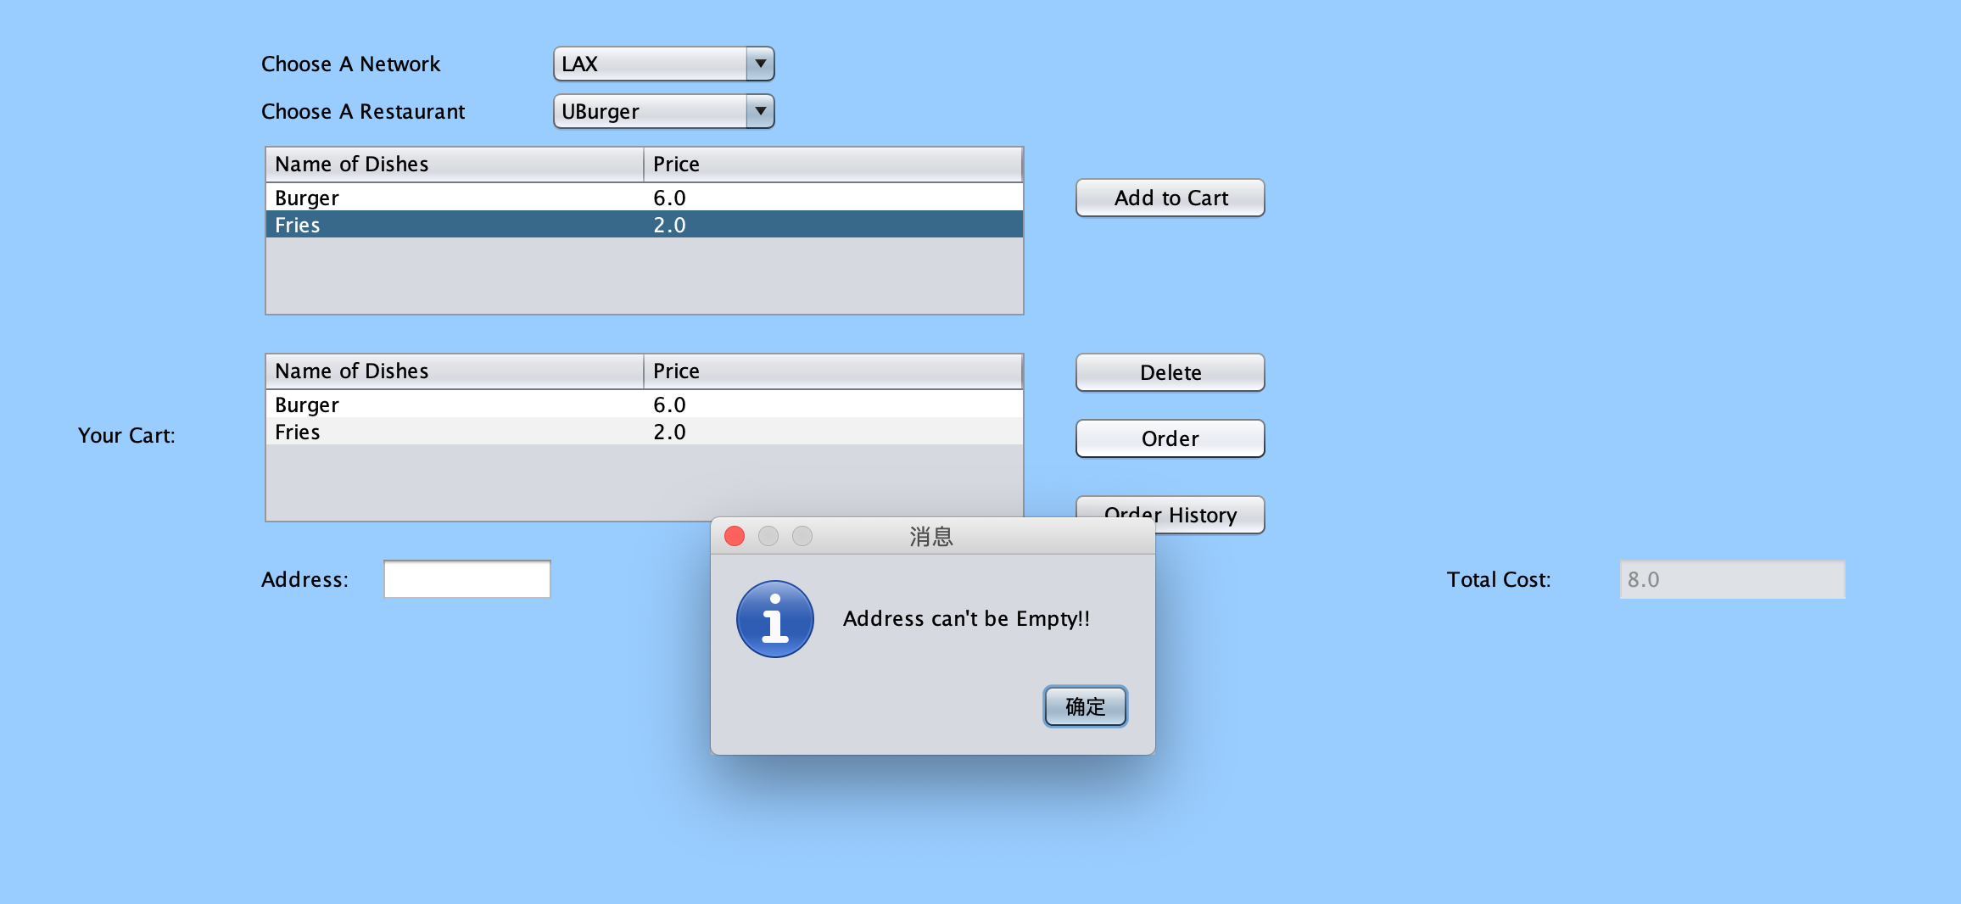
Customer: Place Order

Slide 16
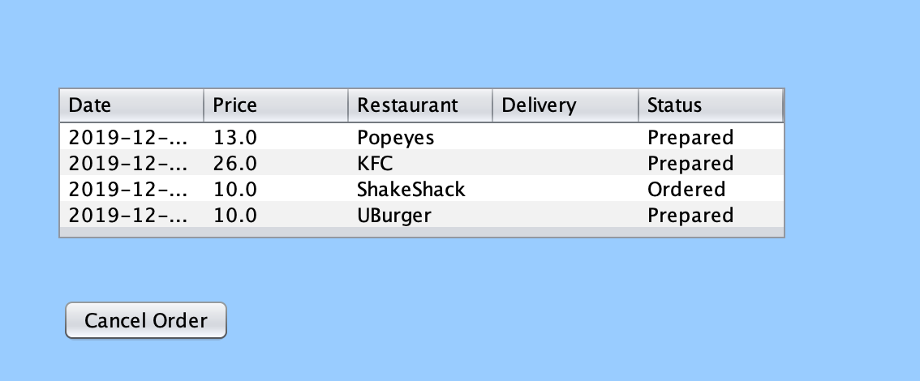
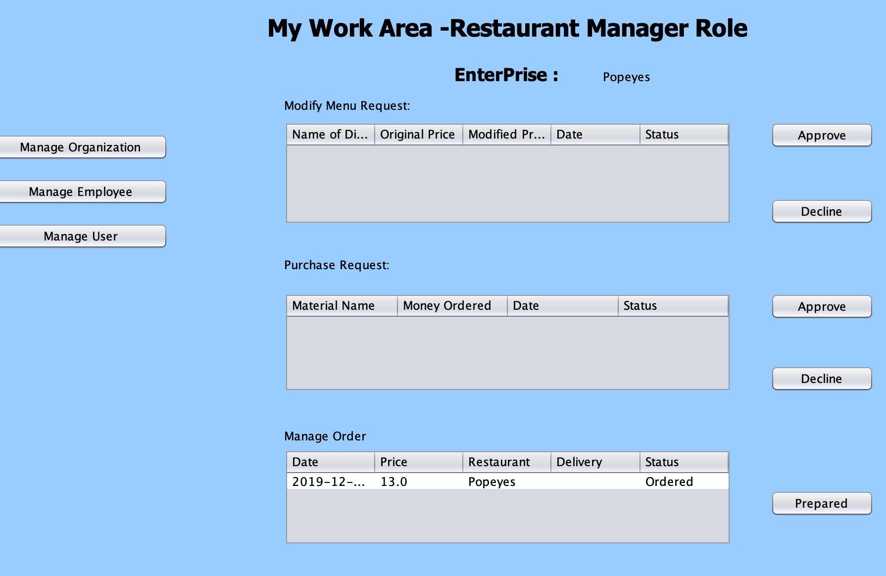
Restaurant：Prepare Meal

Slide 17
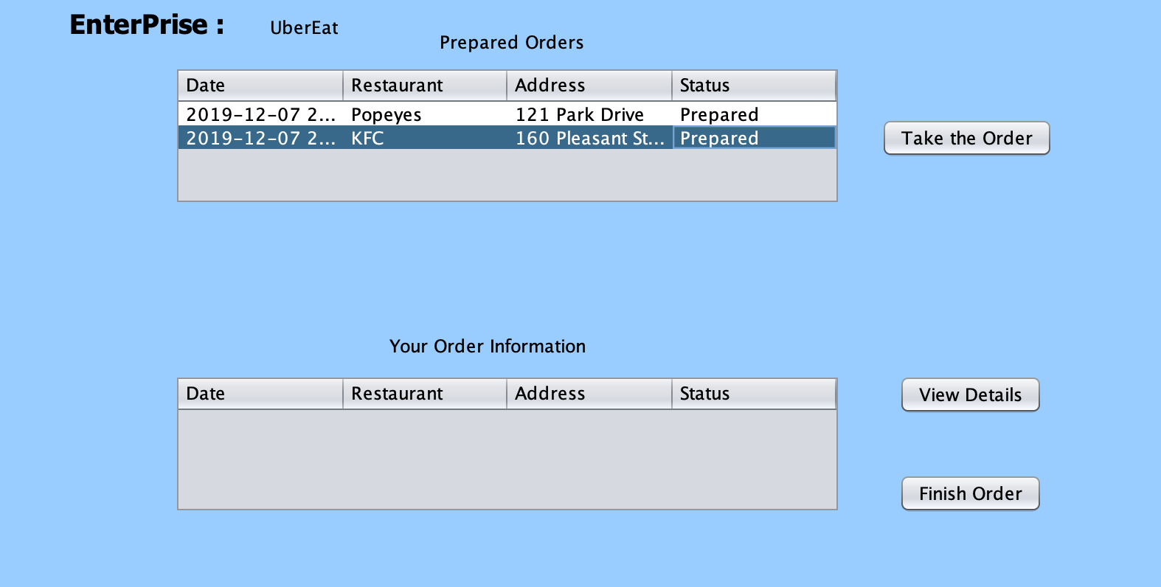
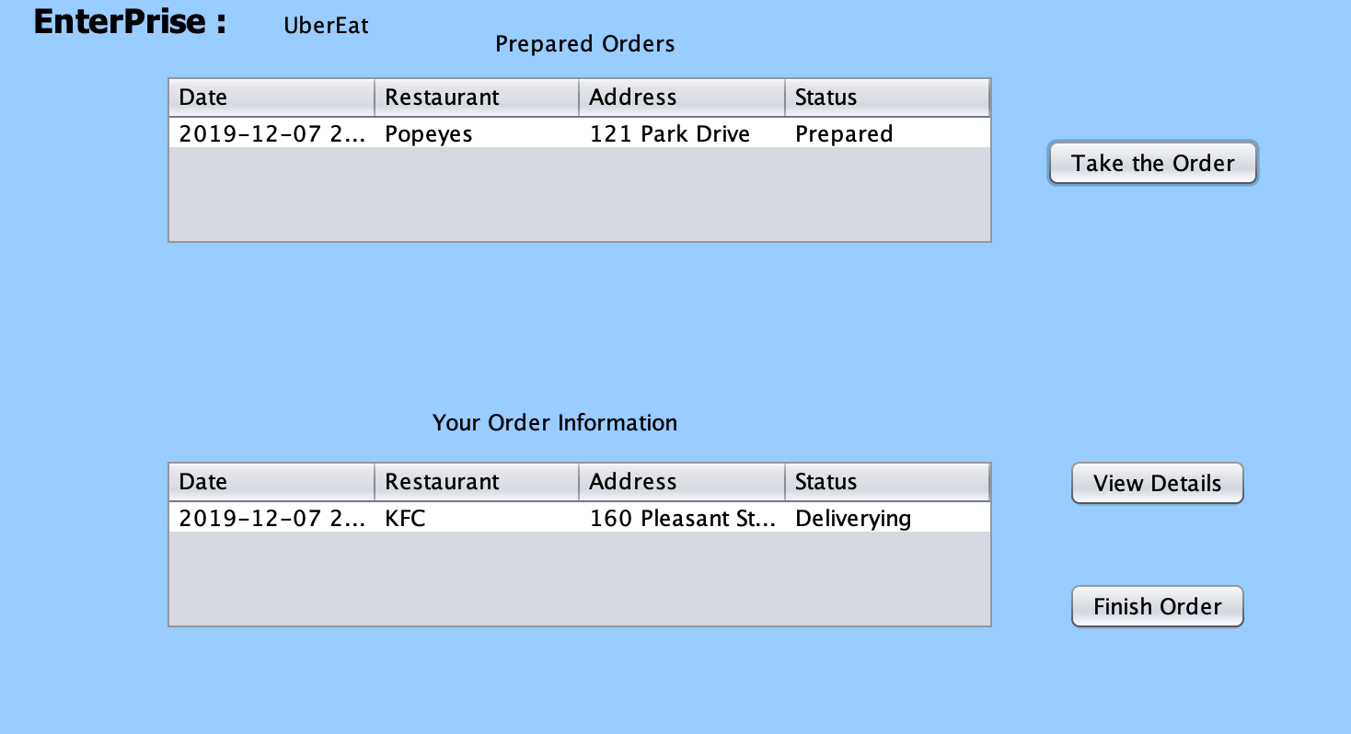
Delivery Company: Deliver Meal

Slide 18
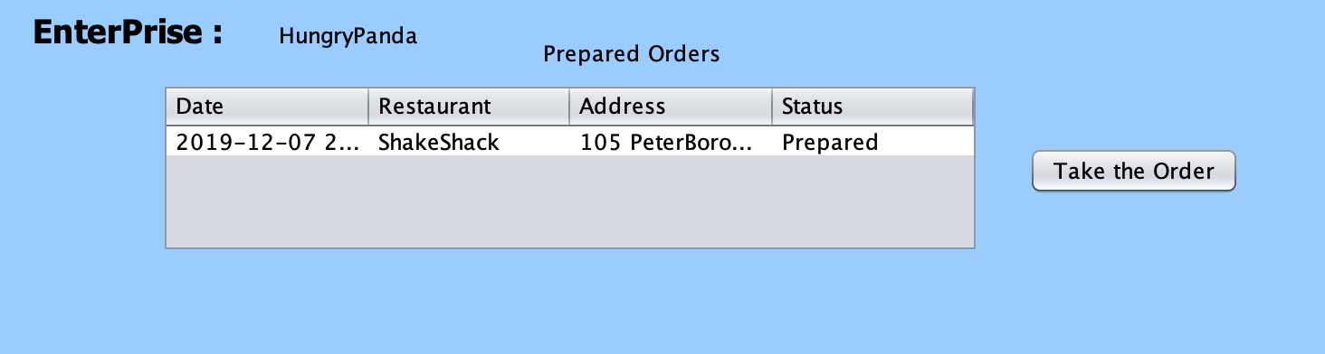

Slide 19
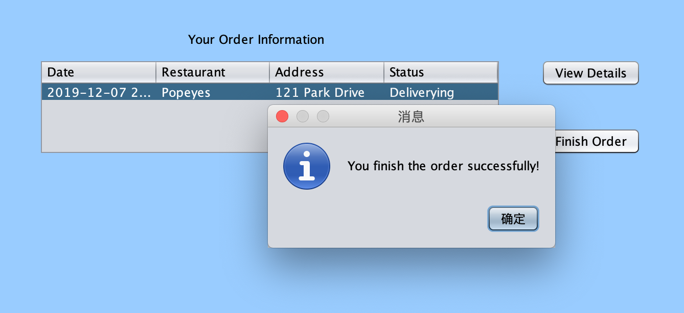
Finish the Order

Slide 20
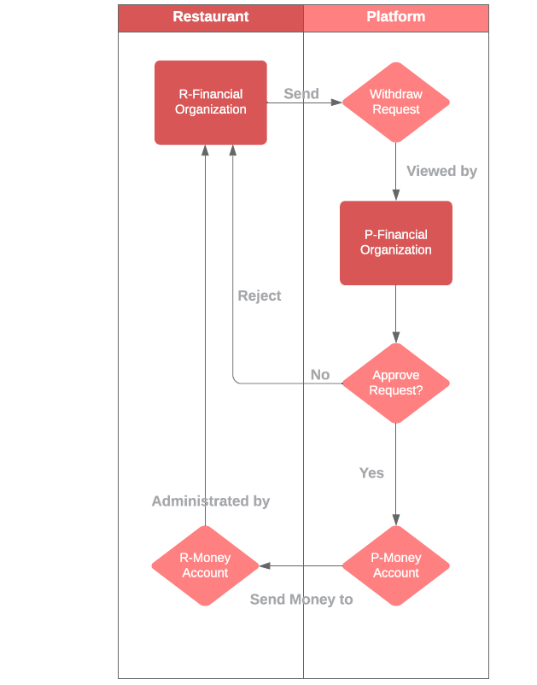
Work flow
3.Profit Transfer

Slide 21
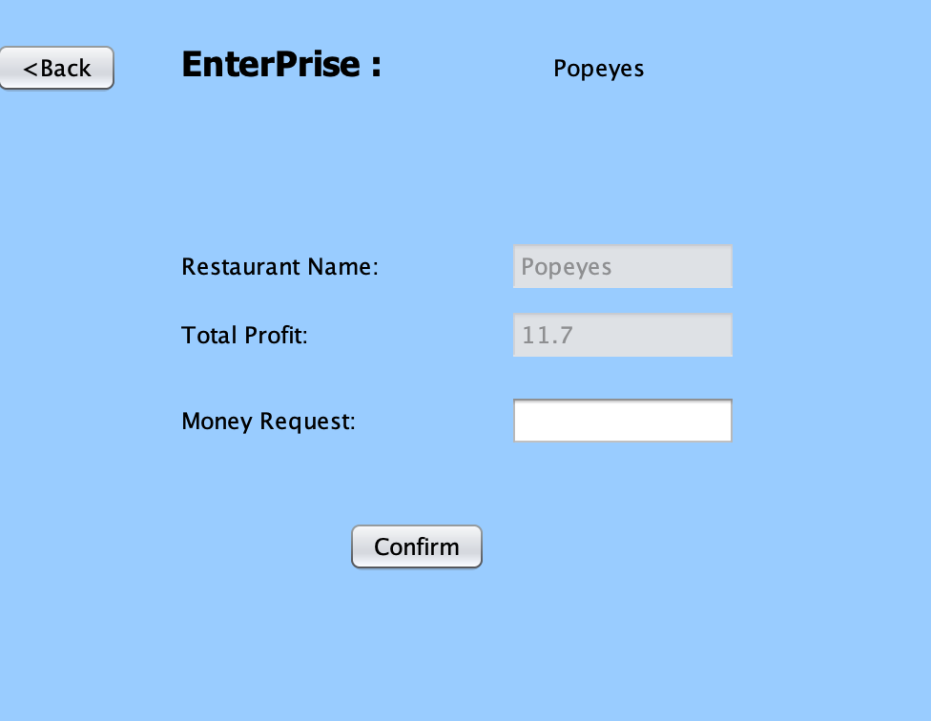
Retaurant send Money Request

Slide 22
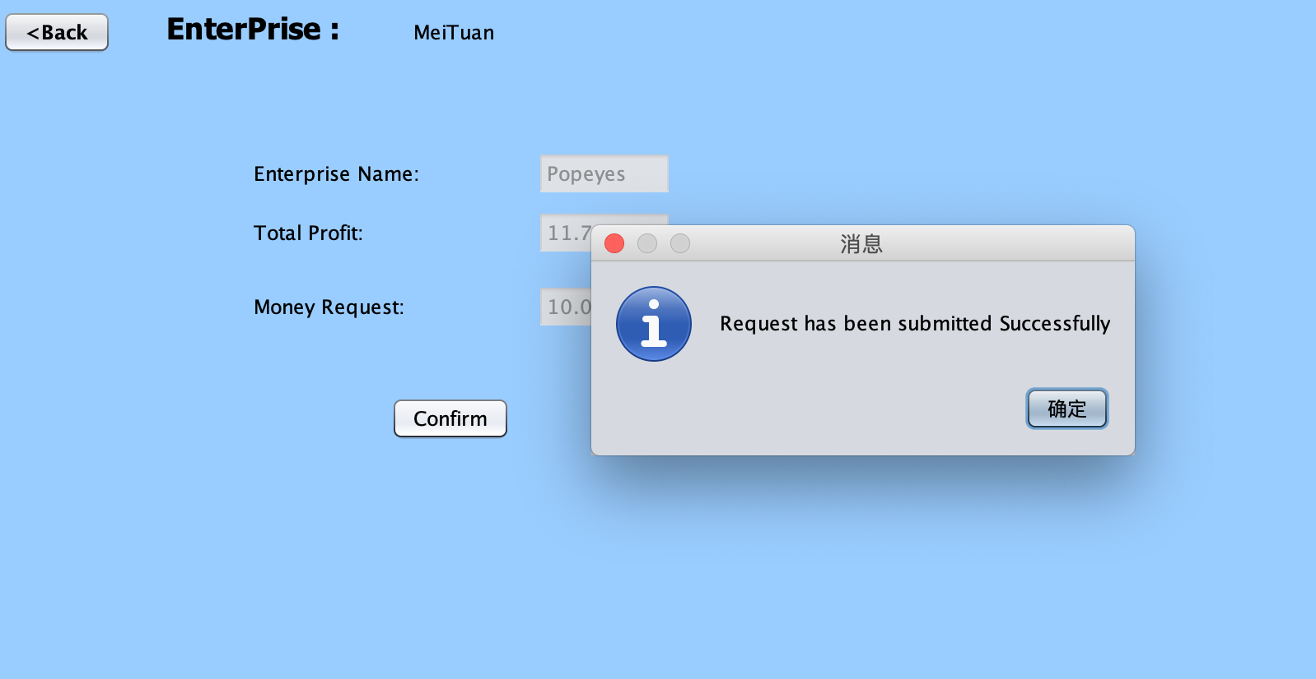
Platform deal with Money Request

Slide 23
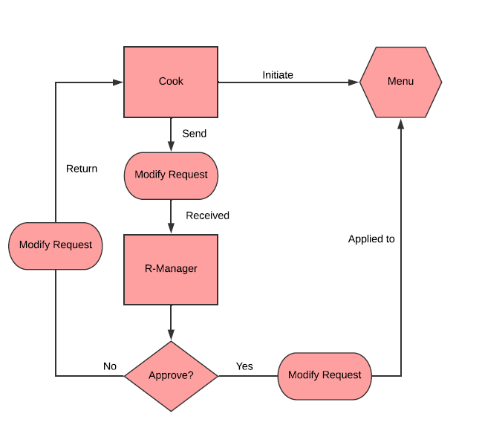
Work flow
4. Menu

Slide 24
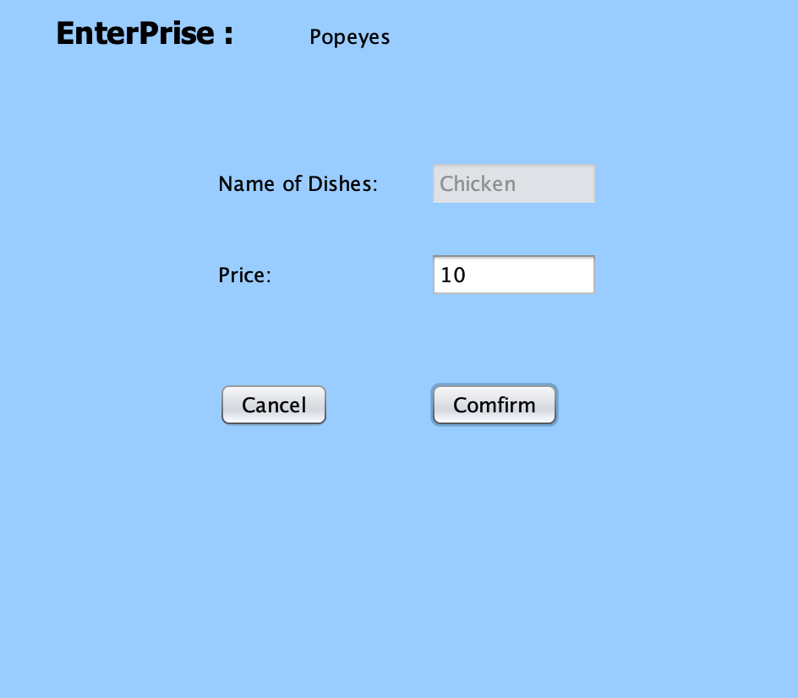
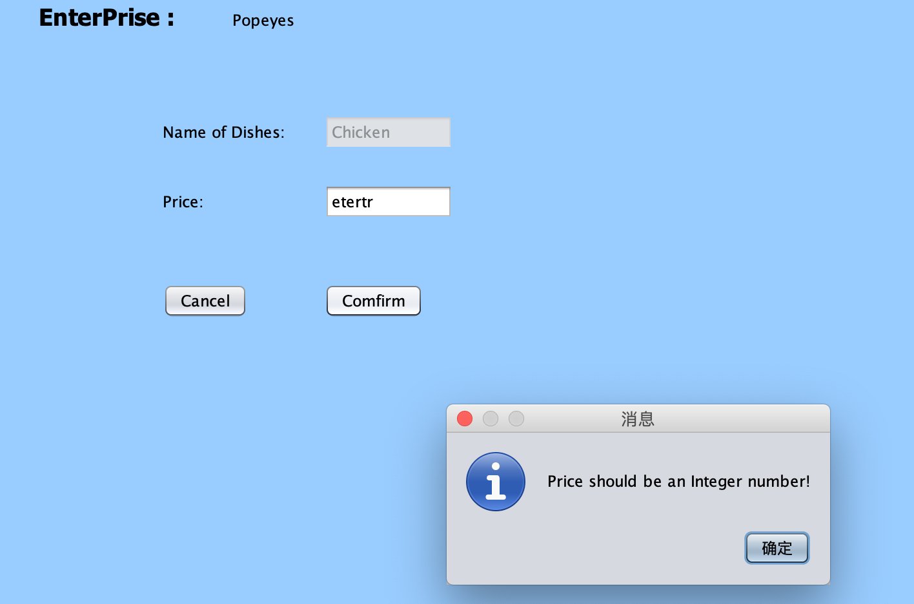
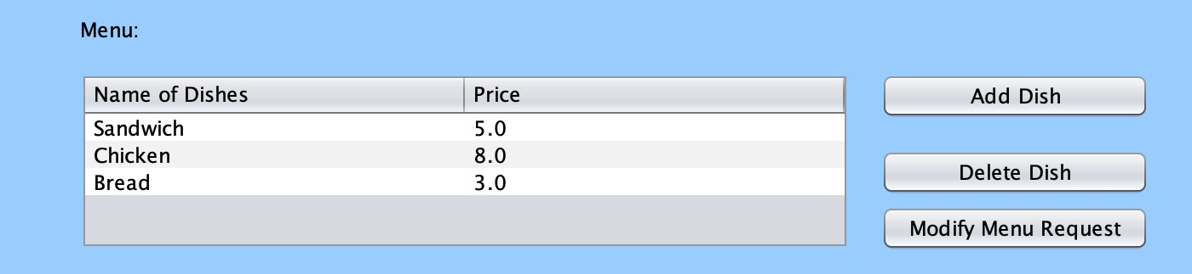
Create Menu

Slide 25
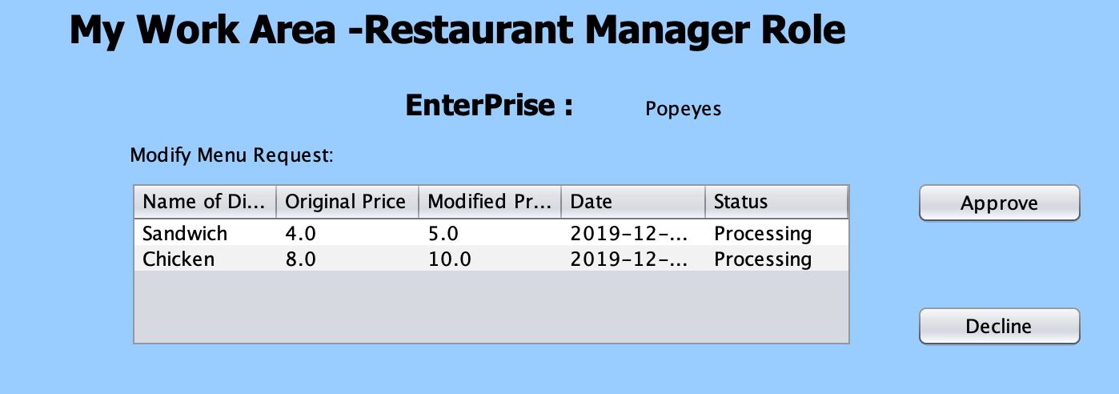
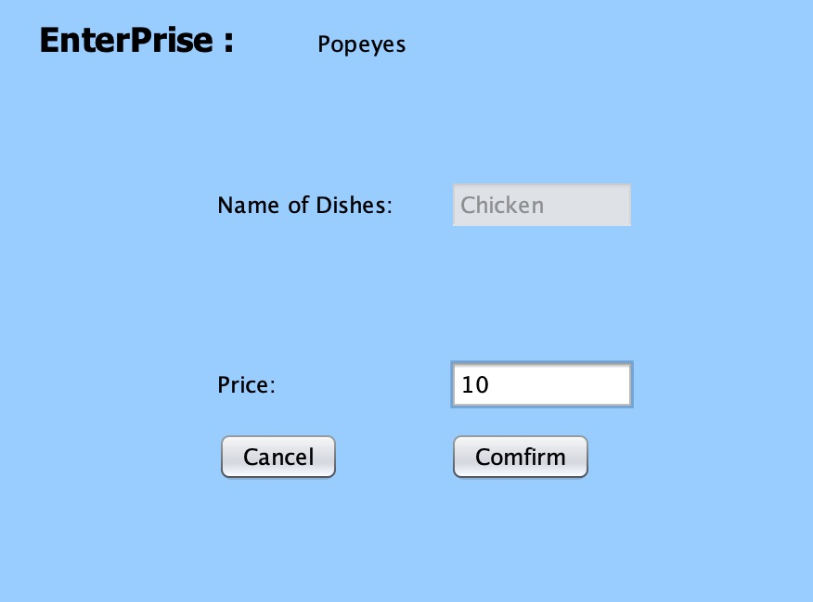
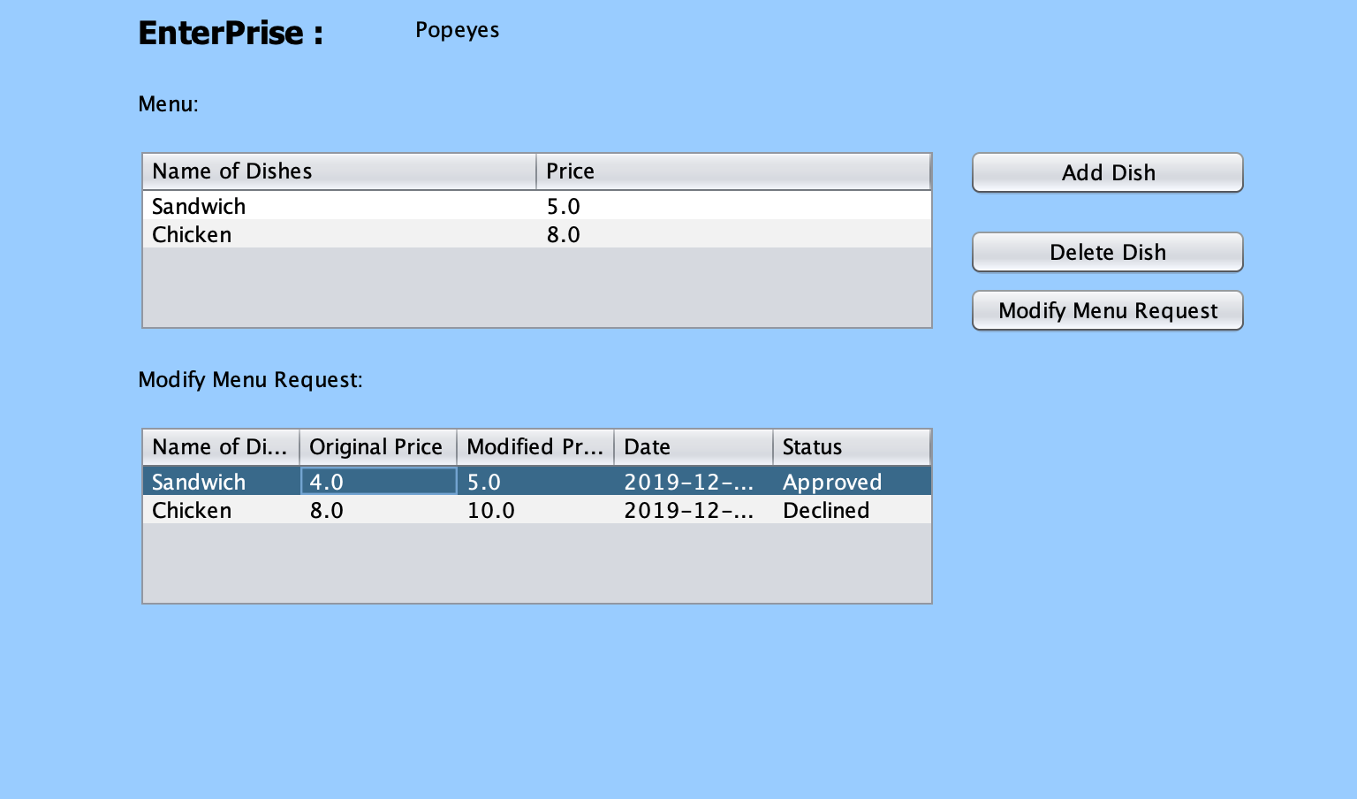
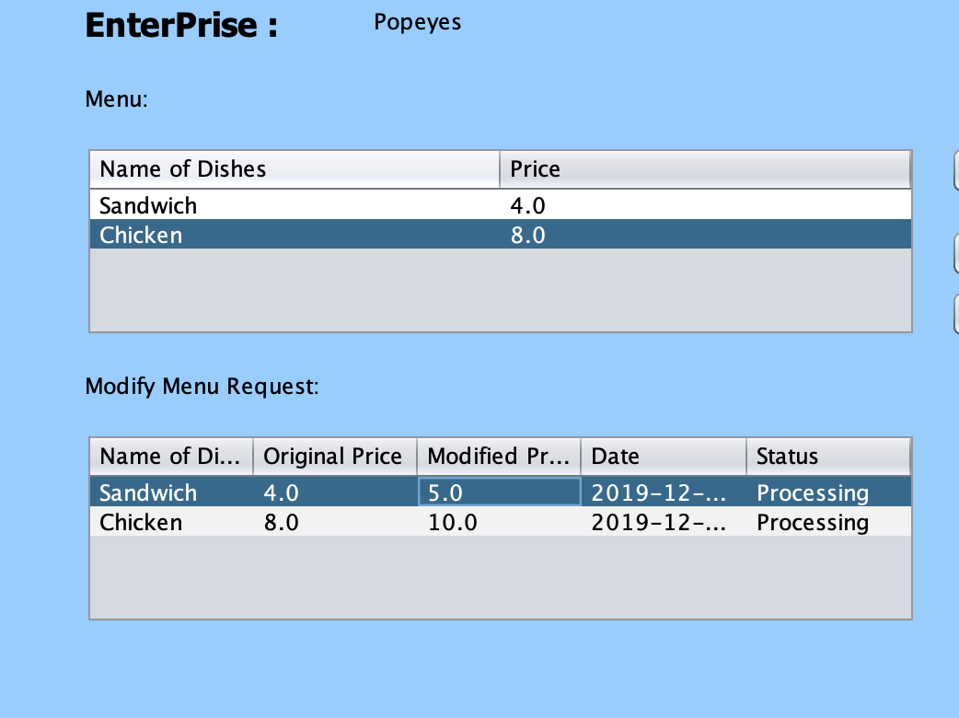
Modify Menu

Slide 26
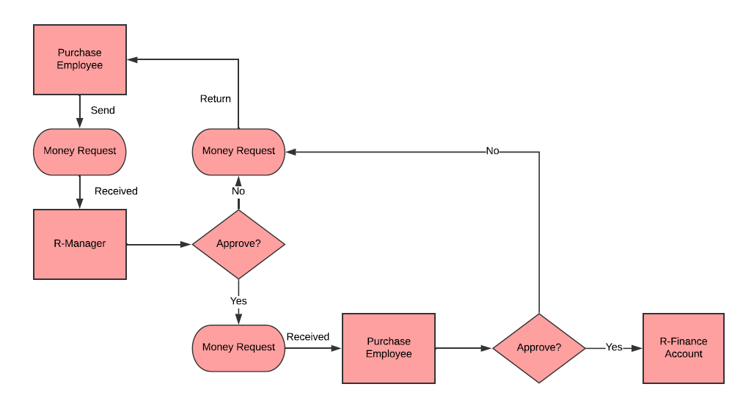
Work flow
5.Purchase

Slide 27
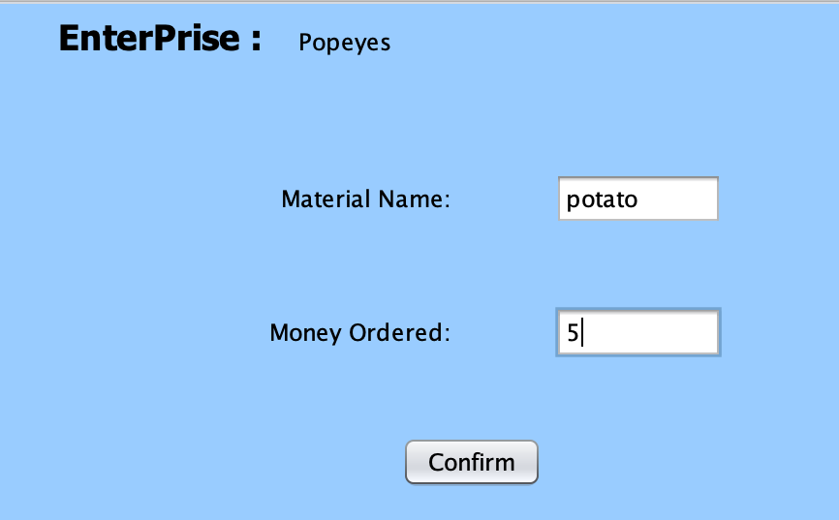
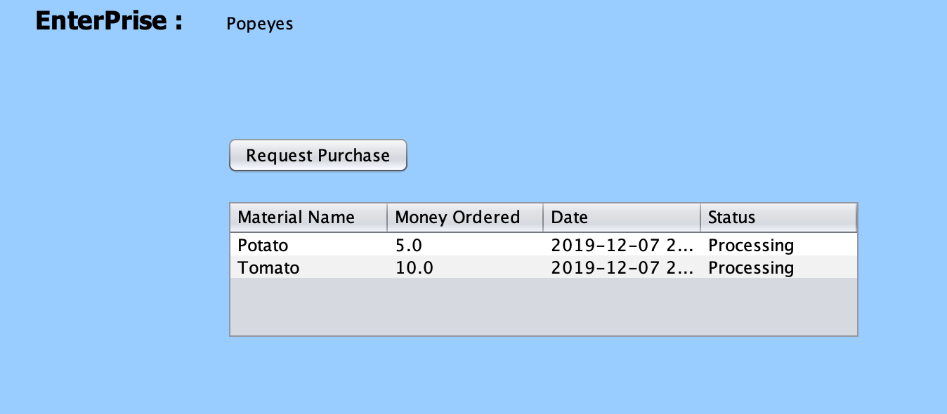
Money Request for Purchasing Ingredients

Slide 28
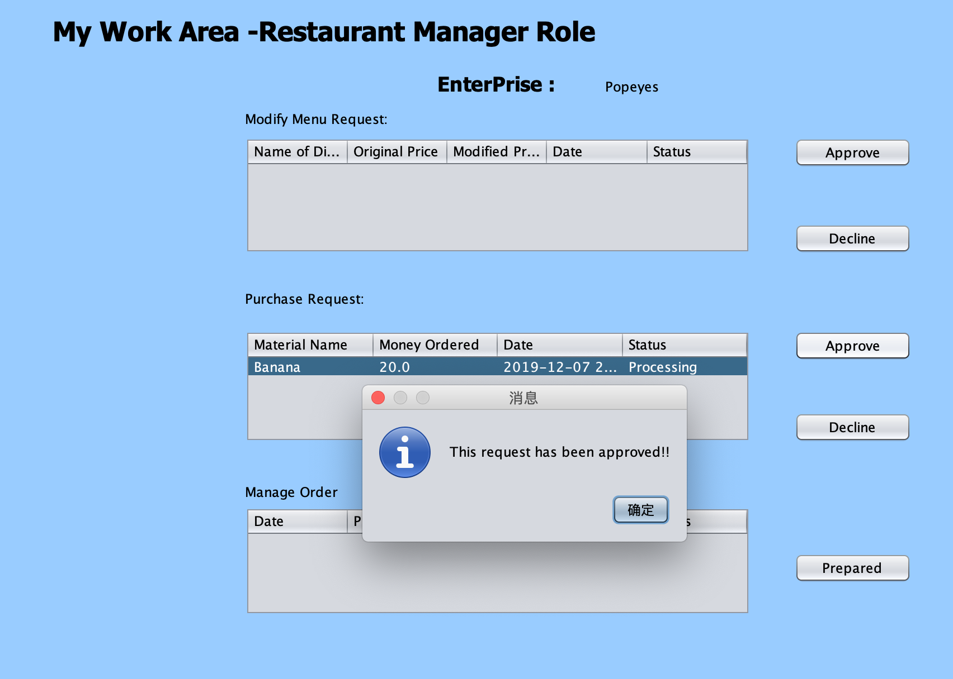
Request Administrated by Manager

Slide 29
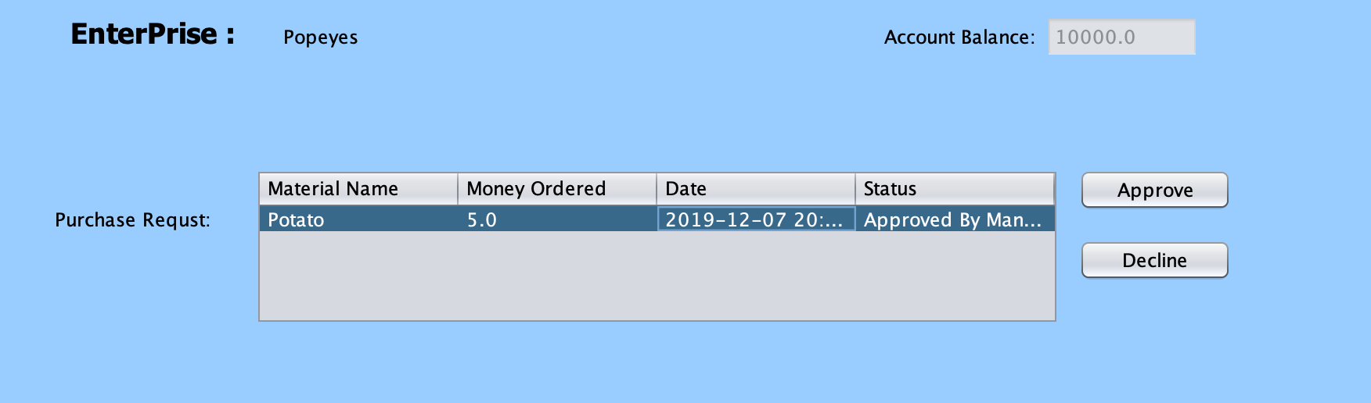
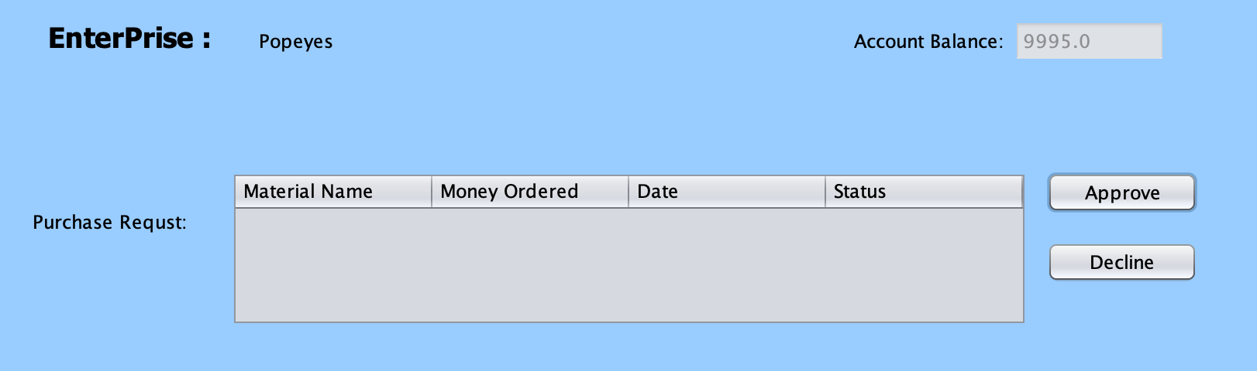
Money Request Administrated by Financial Employee

